Slide 1

Notes:
Script: Welcome to the Merck Animal Health Training about Pinkeye in Cattle. In this training module you will learn about the 3-step approach to prevention. At the end, there will be a short quiz to test your knowledge.

Slide 2
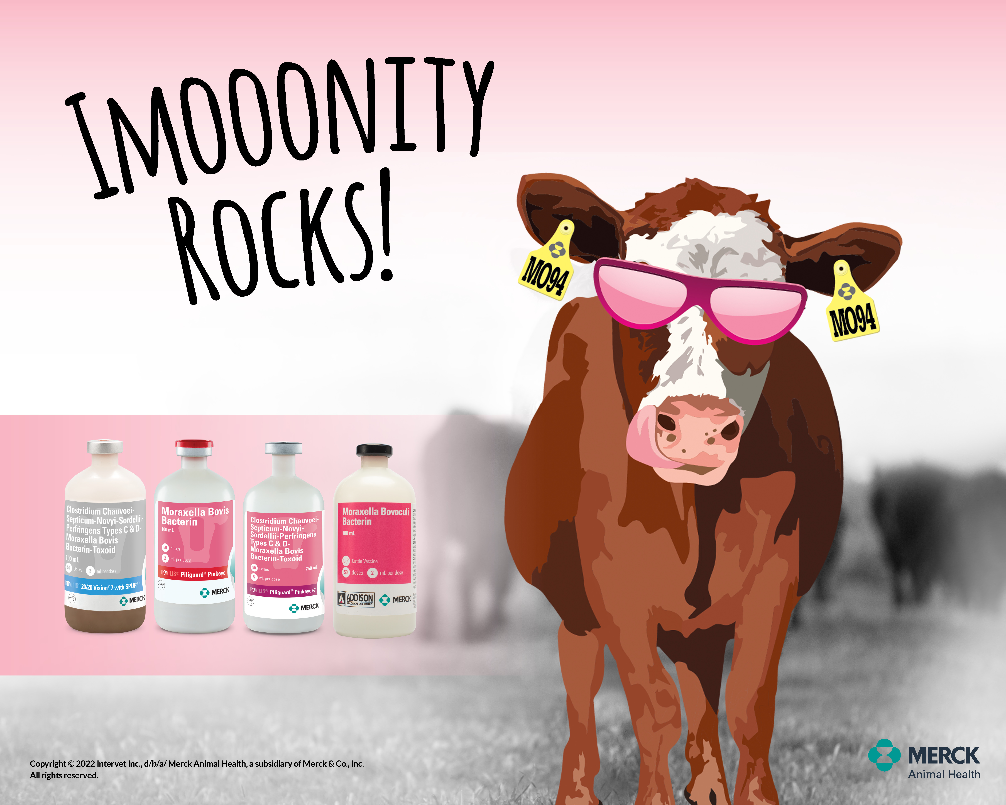
What is Pinkeye? Is it Preventable?
Pinkeye is a bacterial infection of the eye that causes pain, stress and weight loss in cattle of all ages.
Pinkeye is preventable with the 3 Step Approach
Prevention is much easier and affordable than treating pinkeye.
Notes:
Script:
Pinkeye is a bacterial infection of the eye that causes pain, stress and weight loss in cattle of all ages. It is preventable with the 3-step approach. If your customer's cattle go blind or develop clouded eyes, their operation’s profitability will take an additional hit. Prevention is easier and more affordable than treating pinkeye.

Slide 3
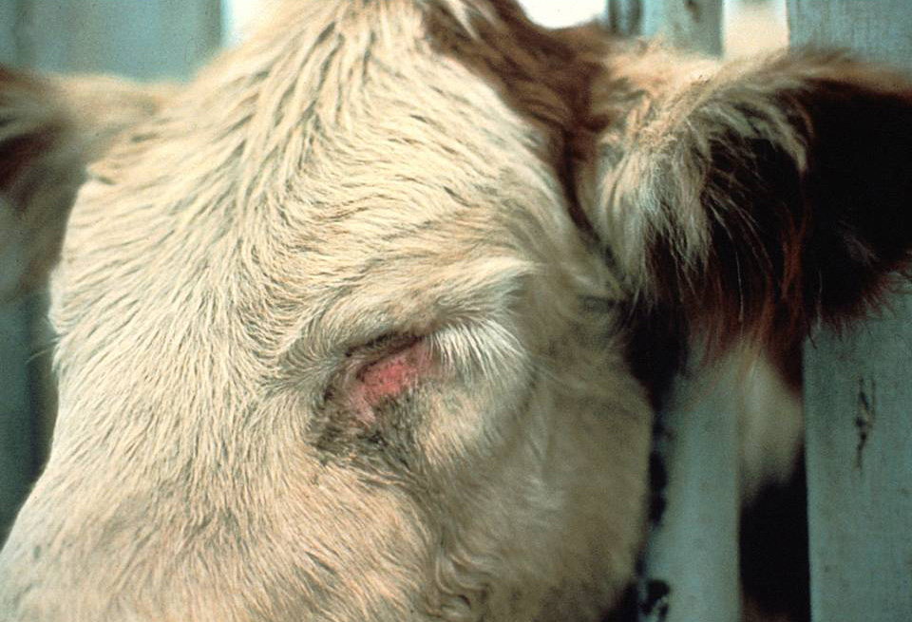
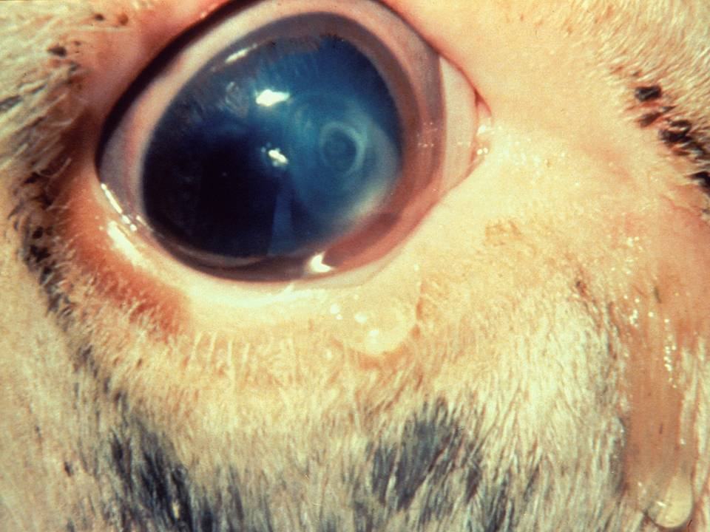
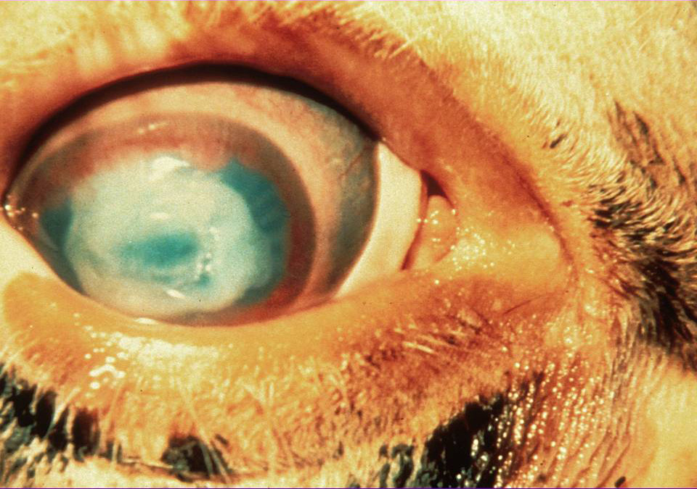
Pinkeye Progress in Cattle
Stage 1
Stage 2
• Eye may look pink or red from enlarged blood vessels
Stage 3
• White spot (ulcer) now covers most of the eye
• Inflammation spreads to the inner part of the eye
• Eye may now appear yellow & “goopy” when it fills with fibrin
• Excessive tearing, blinking and increased sensitivity to sunlight
• Cloudy eye due to inflammation
• May see a white spot which may be a small ulcer
• Symptoms from Stage 1 continue as eye becomes more cloudy
and the white spot (ulcer) spreads
Notes:
Script:
Pinkeye can progress rapidly through three stages. Excessive tearing, redness and small white spots or ulcers that continue to grow and spread is the most common progression. Treatments are available for affected animals, but permanent scarring may still occur. In the case of pinkeye, prevention is the best management strategy to keep your customer’s herd healthy.

Slide 4
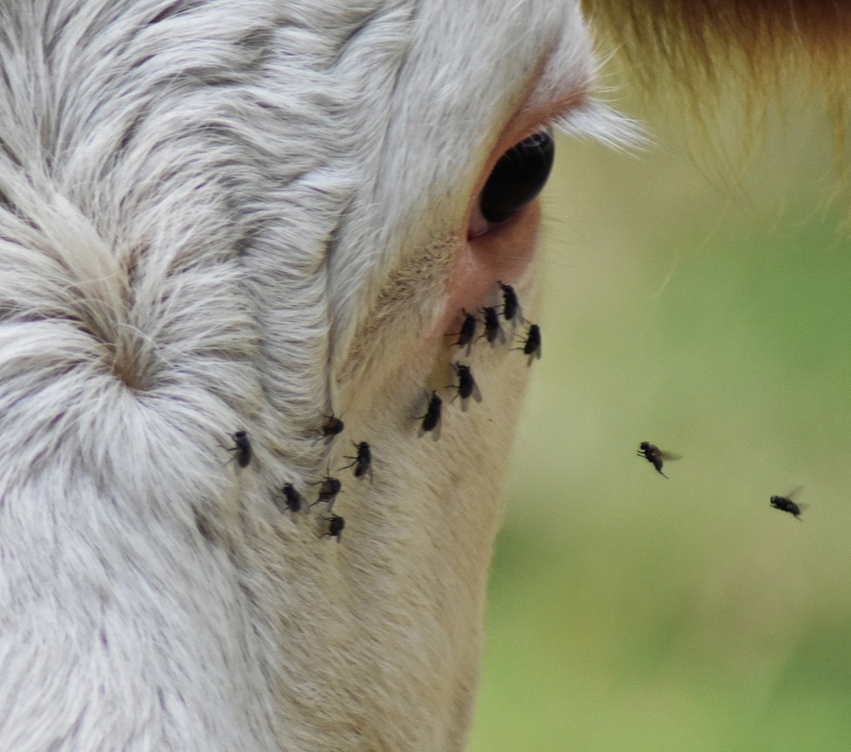
How Does Pinkeye Spread?
Face flies are known to play an important role in the spread of bacteria from an infected animal to a healthy animal
Dust, pollen, tall grasses and UV light are all environmental conditions that can damage cattle’s eyes and provide a growing medium for the pinkeye-causing bacteria to grow
Notes:
Script: Face flies travel from animal to animal, feeding on the watery tearing from cattle’s eyes. This feeding behavior spreads the bacteria to other cattle in close proximity and even those that are miles away. Pinkeye is very contagious, and an outbreak can be challenging to curtail. Environmental factors such as dust, pollen, seed heads and UV light can damage cattle’s eyes which provides a medium for the pinkeye causing bacteria to grow and flourish. Once this occurs, face flies can easily spread pinkeye rapidly among the herd.

Slide 5


Three Steps to Prevent & Stop the Spread of Pinkeye
Vaccination
Fly Control
Environmental Management
Notes:
Script: Pinkeye prevention can be achieved in three steps for most cattle producers by addressing all the causes that contribute to a pinkeye outbreak. The first step is to vaccinate against the most common strains of bacteria that cause pinkeye. The second step is to implement fly control. Effective fly control needs to be tailored to the customer’s operation and climate. The final step is to incorporate environmental management, like mowing pastures, to minimize irritation and injury to the cattle’s eyes and removing breeding grounds for face flies like wet manure around fences and feed bunks.
These three steps are the best management practices to keep pinkeye out of your customer’s herd. Just like a three-legged stool, each step is necessary and vital for success in pinkeye prevention.

Slide 6

Pinkeye Prevention Step 1: Vaccination
Broad spectrum protection against the bacteria that cause pinkeye
The disease is often associated with summer grazing because eye defenses are weakened by sunlight, irritation from flies, dust and plants and their pollen
Vaccinate 3-6 weeks prior to fly/pinkeye season in your area
Administer Booster dose 2-3 weeks later
Consult with a veterinarian about the best time frame to vaccinate
Please refer to the product label directions for additional dosing instructions.
Notes:
Script: Pinkeye vaccines provide broad spectrum protection against the bacteria that cause pinkeye. The best time to vaccinate against pinkeye is three to six weeks prior to the onset of pinkeye season. This can vary from region to region, but most pinkeye cases peak in late summer and early fall. When in doubt, advise that all producers consult with their veterinarian about the best time frame to vaccinate. Please refer to the product label directions for additional dosing instructions.

Slide 7

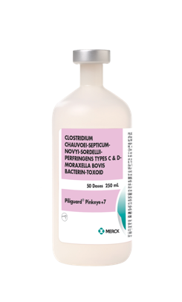
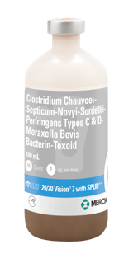
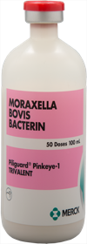
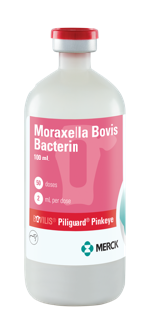
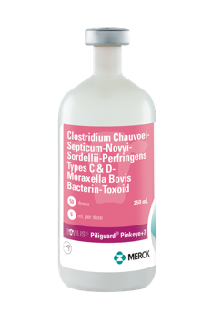
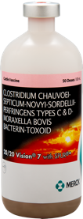
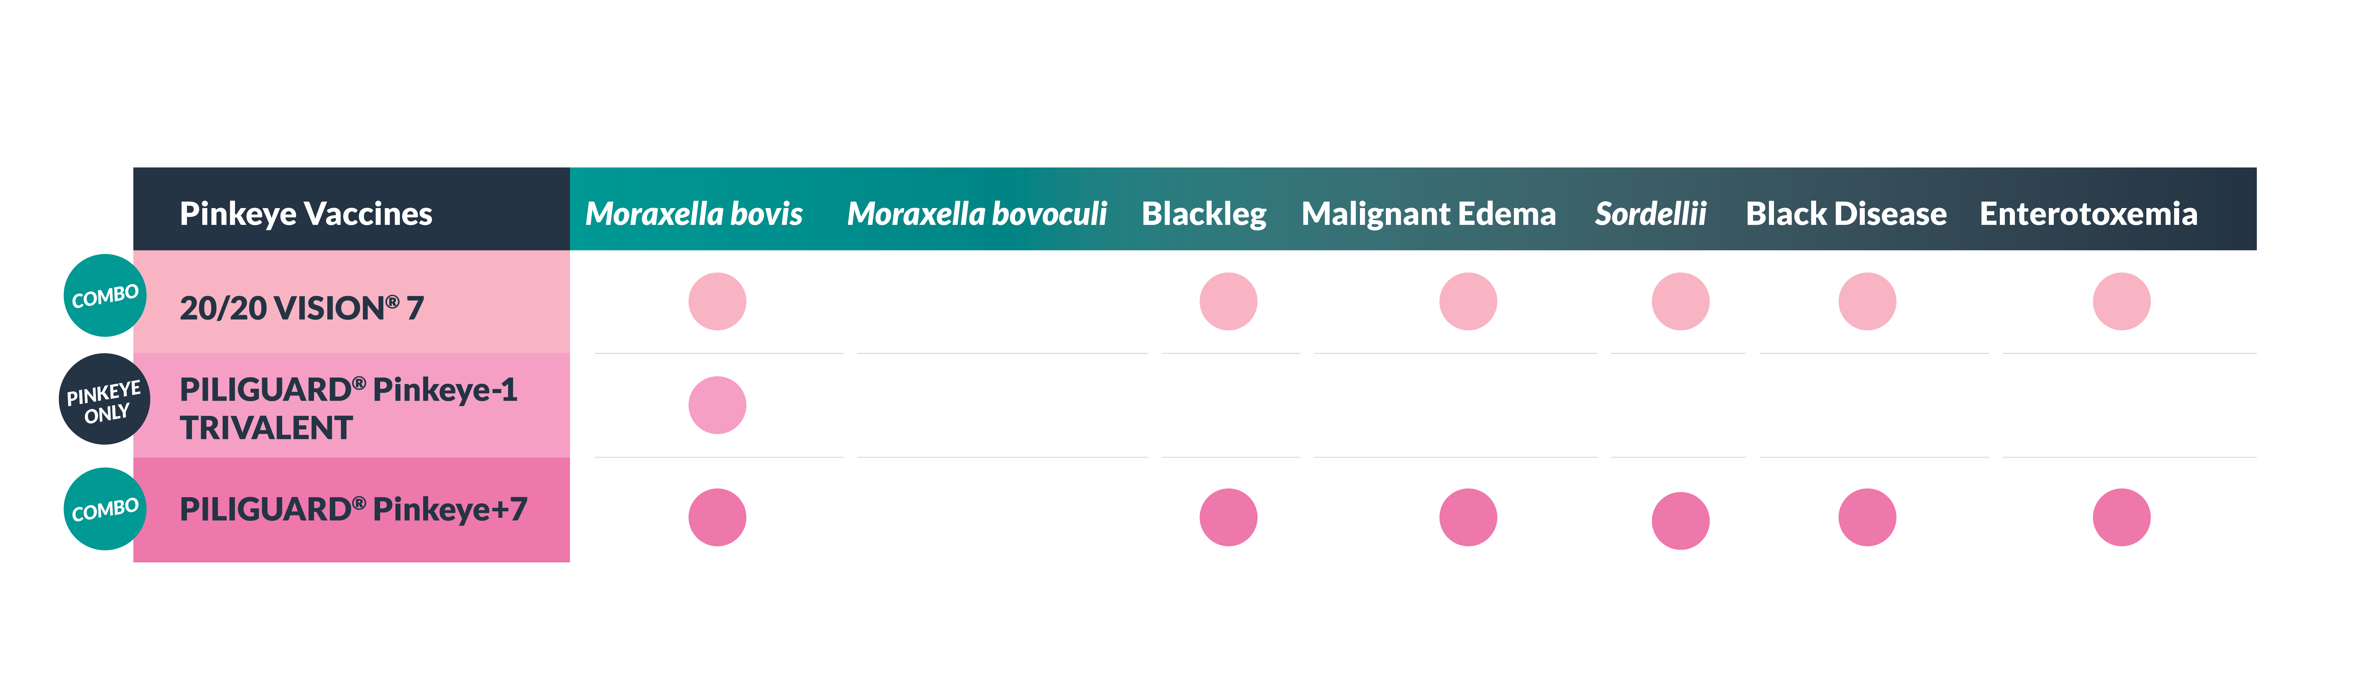
Pinkeye Prevention Step 1:
Vaccines Available
BOVILIS® 20/20 VISION® 7 with SPUR®
BOVILIS®
PILIGUARD® Pinkeye
BOVILIS®
PILIGUARD® Pinkeye+7
Vaccine package & name change coming 2021/2022
Notes:
Script: There are three main vaccine options available to help your customers. BOVILIS® 20/20 VISION® 7 with SPUR® provides broad-spectrum protection against pinkeye and clostridial diseases and is an ideal option for producers who want to combine vaccinations and minimize stress to the herd. In addition, BOVILIS® PILIGUARD® Pinkeye+7 helps prevent common clostridial diseases along with pinkeye.
BOVILIS® PILIGUARD® Pinkeye is effective in providing broad spectrum protection against common strains of bacteria that cause pinkeye.

Slide 8
Pinkeye Prevention Step 2: Fly Control
At the beginning of fly season – Tag & Pour
Throughout fly season – Monitor & Pour
Additionally, as needed – Spray Premises
¹Arnold, Michelle – DVM (Ruminant Extension Veterinarian) University of Kentucky. “Preparing for Pinkeye” Ohio BEEF Cattle Letter published by Ohio State University Extension Beef Team, June 20, 2018.
Notes:
Script:
Face flies may travel as far as four miles¹, meaning they can travel from one farm to the next, during their lifespan. They can carry pinkeye-causing bacteria for two to three days¹. The good news is that best management practices can really reduce your customer’s fly population. At the beginning of fly season, tag cattle with an insecticide ear tag like DOUBLE BARREL® VP that protect cattle’s head and face area. At the same time, apply a pour-on insecticide like ULTRA BOSS® along the spine and down the face for fly control.
Throughout the fly season, make sure to monitor the fly levels on the cattle. Re-apply the pour-on insecticide according to instructions. Producers can also use insecticides like ULTRA BOSS® in back rubbers or oilers to further reduce flies during peak times or wet conditions. Make sure to monitor frequently on a regular schedule. Additionally, producers can also use GRENADE® ER to spray the premises for broad spectrum pest control which includes flies, beetles, spiders and ticks.
___________________________
¹Arnold, Michelle – DVM (Ruminant Extension Veterinarian) University of Kentucky. “Preparing for Pinkeye” Ohio BEEF Cattle Letter published by Ohio State University Extension Beef Team, June 20, 2018.

Slide 9
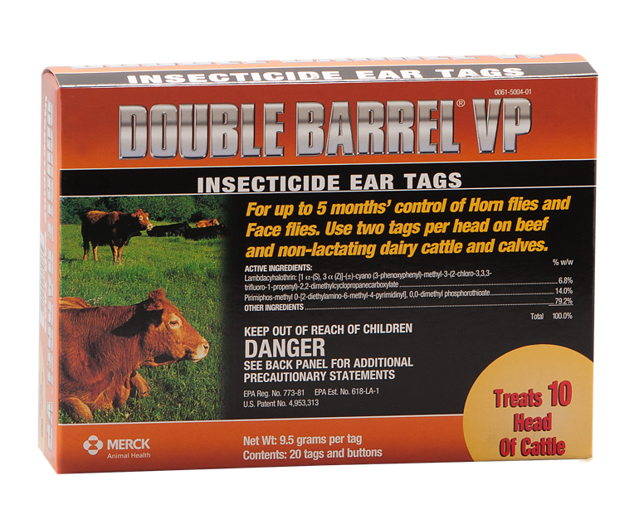
Pinkeye Prevention Step 2:
Fly Control Products – Insecticide Tags
DOUBLE BARREL® VP insecticide tags utilize two active ingredients to maximize control and minimize potential resistance
  For use on beef cattle, non-lactating dairy cattle and calves of all ages
  Use two ear tags per animal to control horn flies and face flies for up to 5 months
  1 box treats 10 head
  Please use latex gloves when applying tags
Notes:
Script:
DOUBLE BARREL® VP insecticide tags provide protection for cattle against pesky horn and face flies. DOUBLE BARREL® uses two ingredients to maximize control and minimize potential resistance. These tags are for use on beef cattle of all ages and stages. Use two tags, one in each ear to provide continuous control for up to five months. The unique triangle shape of the tags prevents the tags from breaking off whenever cattle flip their head or ears from side to side. The cattle’s natural movement helps spread the insecticide from the tag to their skin, making the tags highly effective.

Slide 10
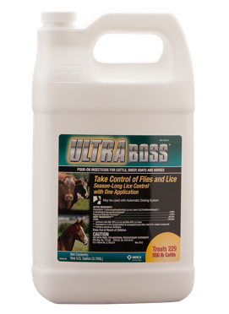
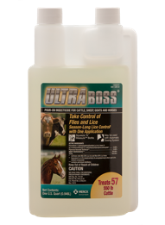
Pinkeye Prevention Step 2:
Fly Control Products – Pour-On Insecticides
A permethrin pour-on insecticide for cattle, sheep, goats and horses that provides long lasting control against lice, horn flies, face flies, horse flies, stable flies, mosquitoes, black flies and ticks
  ULTRA BOSS is for use in lactating animals
  and has no preslaughter withdrawal or milk
  discard in cattle
  This pour-on is also approved for use in back rubbers – making treatment easy and convenient
  1 application is effective for up to 8 weeks
  1 Quart treats 57 head of 550 lb. cattle
ULTRA BOSS®
Notes:
Script:
Pour-on insecticides are a convenient product to use on cattle or in back rubber applications. ULTRA BOSS® is a long-lasting pour-on that controls a broad spectrum of flies and pests. ULTRA BOSS® is for all ages of cattle and has no withdrawal period. It is also approved for use in back rubbers – making treatment easy and convenient.

Slide 11
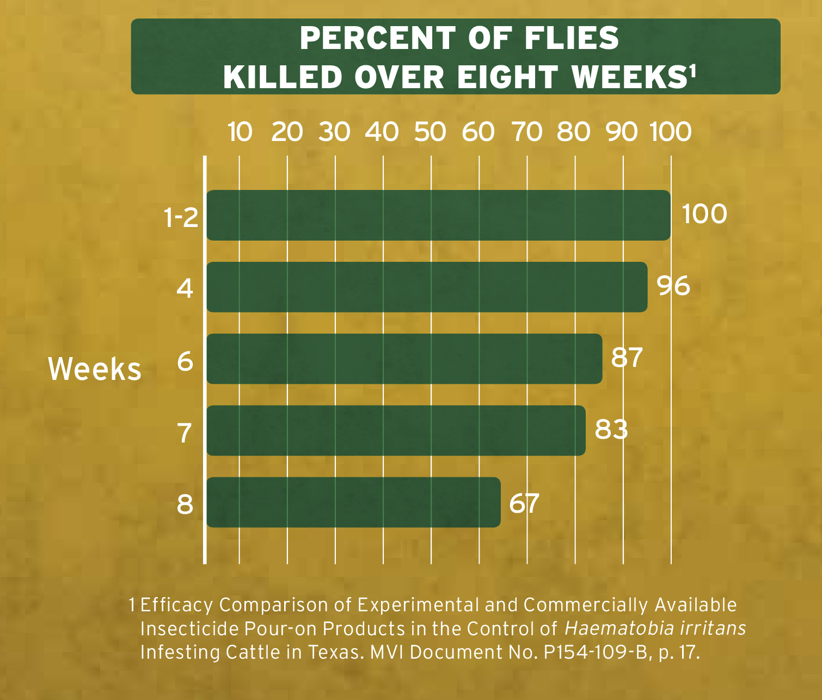
Pinkeye Prevention Step 2:
Fly Control Products – Pour-On Insecticides
ULTRA BOSS®
Notes:
Script:
1 application of ULTRA BOSS kills 100% of flies during the first 2 weeks and remains effective for up to 8 weeks

Slide 12
Pinkeye Prevention Step 3:
Environmental Management
Maintain an environment that reduces dusty and excessively wet conditions
Mow tall grass with seed heads
Provide shade for protection against UV light (sunlight)
Provide ample fresh, clean water to keep cattle well hydrated
  Water keeps surface of the eye wet and healthy
  Proper hydrations is crucial in dry, dusty and/or windy conditions
Reduce sources of stress, such as overcrowding
Discuss a mineral program with a nutritionist
Incorporate a strategic deworming and vaccine program to improve immune response to disease
Notes:
SCRIPT: The final step in the three-part approach to prevent pinkeye is to evaluate the producer’s environmental management practices. Finding ways to minimize eye irritants in the environment is a critical component of preventing pinkeye. Reducing dusty and excessively wet conditions, keeping grass at optimal height, mowing grass with seed heads, providing enough fresh, clean water to maintain a wet surface of the eye and reducing stress from overcrowding all add up to create a reduced risk of pinkeye. Remember any eye irritation can be an invitation to pinkeye causing-bacteria to grow and thrive. It is imperative to discus a mineral program with a nutritionist and incorporate a strategic deworming and vaccine program to improve immune response to disease.

Slide 13
3 Easy Steps to Protect Cattle from Pinkeye
Vaccination
Fly Control
Environmental Management
• Vaccinate 3-6 weeks prior to pinkeye season
• Ear Tags
• Pour-on Insecticide
• Premise Spray
• Booster per label instructions
• Reduce eye irritants such as dust, pollen, tall grasses
and UV light (sunlight)
• Keep cattle well hydrated
• Reduce sources of stress, such as overcrowding internal
parasitism
• Discuss mineral program with a nutritionist
Notes:
SCRIPT:
Your customers need to do all three steps to have a proper pinkeye prevention on their farm or ranch. Remind your customers that there is a powerful array of products available to vaccinate, implement fly control and reduce eye irritants in their environment. Combine all three steps to prevent painful pinkeye and keep their cattle healthy and happy.

Slide 14
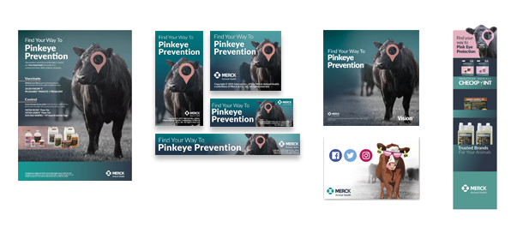
Find these assets at MORERetailPower.com
Digital Ads
Print Ad
Social Media
Merchandizer
Copyright © 2021 Intervet Inc., d/b/a Merck Animal Health, a subsidiary of Merck & Co., Inc. All rights reserved.
Notes:
SCRIPT:
Find these assets and more at MORERetailPower.com

Slide 15
THANK YOU
Copyright © 2021 Intervet Inc., d/b/a Merck Animal Health, a subsidiary of Merck & Co., Inc. All rights reserved.
Notes:
SCRIPT: Thank you for taking the time to review the 3 Step Approach to Prevent Pinkeye in Cattle training module from Merck Animal Health.
If you have any questions, please reach out to your Merck Animal Health Representative.
Now we will test your knowledge with 4 quiz questions.

