Slide 1
Nobivac® Vaccine Guarantee Merck Animal Health

Slide 2
Guarantee terms
Merck Animal Health guarantees the efficacy of its Nobivac® vaccines for dogs and cats in consideration with the current American Animal Hospital Association (AAHA) and American Association of Feline Practitioners (AAFP) Guidelines, which support lifestyle vaccination and flexible revaccination periods, independent of the label claims of our vaccines.
This guarantee will cover diagnostic and treatment costs up to $5000 in cases where the animal contracts a disease for which it has been vaccinated with a Nobivac® vaccine.
In the unfortunate event that a pet should succumb to the disease, Merck Animal Health will offer up to $1000 toward the purchase of a new pet.
This guarantee only applies to Merck Animal Health Nobivac® vaccines listed in this Nobivac® Guarantee administered by, or under the supervision of, a licensed veterinarian. The vaccine must have been purchased directly from Merck Animal Health or from an authorized distributor purchasing directly from Merck Animal Health.*
Guarantee coverage may be subject to confirmatory diagnostics. Merck Animal Health is not responsible for lost diagnostic samples. Inconclusive results will be handled on a case-by-case basis.
*Additional conditions apply. See program details.

Slide 3
Duration of support
Because we know your clients are busy and can’t always get in on time…
Merck Animal Health has you covered. Our Nobivac® Vaccine Guarantee extends 3 months beyond the vaccine duration (excluding Nobivac® Rabies).
Pets can be up to 3 months overdue and still be covered under the Nobivac® Guarantee. For complete coverage, pets must have received an initial series and a 1-year booster where appropriate.

Slide 4
Duration of support: Canine vaccines
3 Years (+3 mo)
Nobivac® Canine 3-DAPv
Nobivac® Canine 1-DAPPv*
Nobivac EDGE® DAPPv*
Nobivac® Canine 1-DAPPvL₂*†
Nobivac® Canine 1-DAPPv + L₄*†
Nobivac EDGE® DAPPv + L₄*†
Nobivac® Canine 1-DAPPvL₂ + Cv*^{†N}
Nobivac® Canine 1-DAPPv + Cv*†
Nobivac® Canine 1-Pv*
Nobivac® Puppy-DPv*
*Nobivac® 1 products require a 1-year booster for 3-year (+3 mo) guarantee.
†1-year (+3 mo) guarantee for leptospirosis (L2, L4) and coronavirus (Cv).
1 Year (+3 mo)
Nobivac® Canine 1-Cv
Nobivac® Lepto₄
Nobivac EDGE® Lepto₄
Nobivac® Lyme
Nobivac® Intra-Trac® KC
Nobivac® Intra-Trac® Oral BbPi
Nobivac® Intra-Trac® Oral Bb
Nobivac® Intra-Trac®₃
Nobivac® Intra-Trac®₃ ADT
Nobivac® NXT Canine Flu H3N2
Rabies (1 or 3 years)
Nobivac® 3-Rabies
Nobivac® 3-Rabies CA
Nobivac® 1-Rabies

Slide 5
Duration of support: Feline vaccines
3 Years (+3 mo)
Nobivac® Feline 3-HCP
Nobivac® Feline 1-HCP*
Nobivac® Feline 1-HCP + FeLV*†
Nobivac® Feline 1-HCPCh*‡
Nobivac® Feline 1-HCPCh† +FeLV*†
*Nobivac® 1 products require a 1-year booster for 3-year (+3 mo) guarantee.
†2-year guarantee for Feline Leukemia (FeLV).
‡1-year (+3 mo) guarantee for Chlamydia (Ch).
2 Year (+3 mo)
Nobivac® Feline 2-FeLV Nobivac ® NXT FeLV
1 Year (+3 mo)
Nobivac® Feline-Bb
Rabies (1 or 3 years)
Nobivac® 3-Rabies
Nobivac® 3-Rabies CA
Nobivac® 1-Rabies

Slide 6
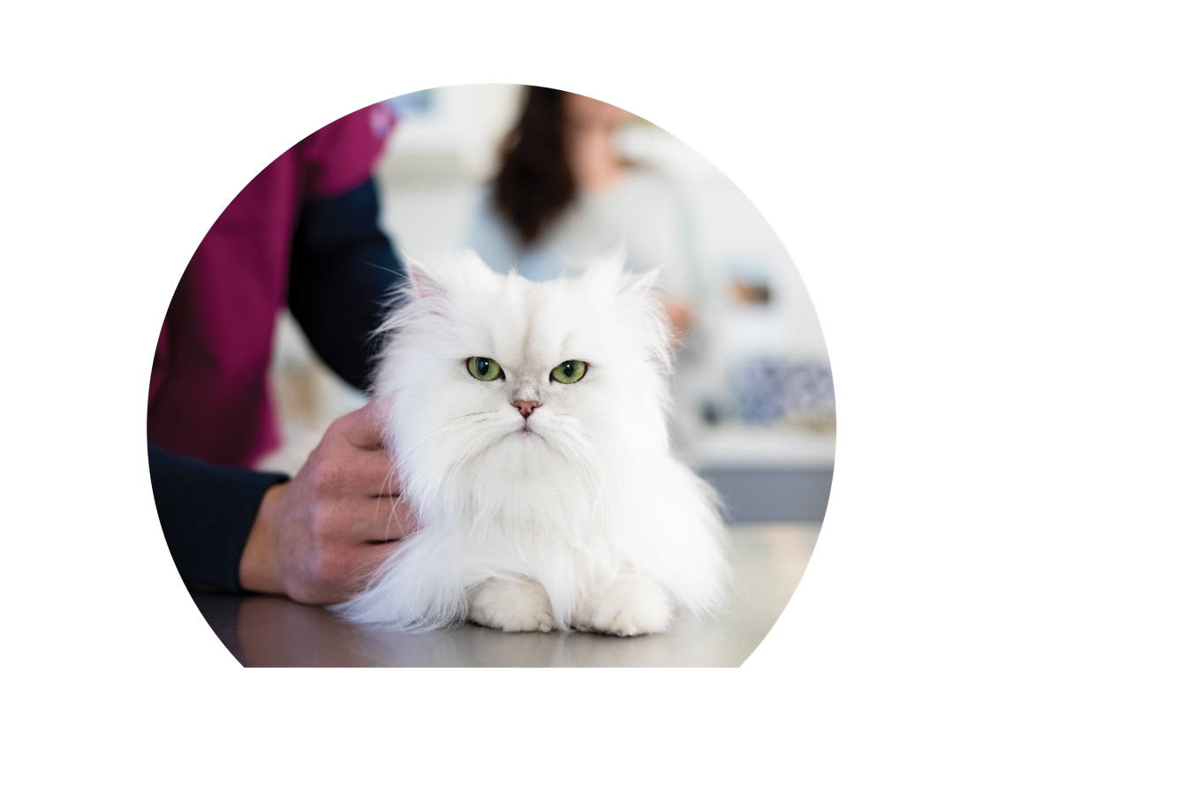
Program details
All pets must be vaccinated by, or under the supervision of, a licensed veterinarian with an established client–patient relationship. All vaccines must be administered in accordance with the labeled directions for administration and local regulations.
Documentation of vaccination records must be maintained on file by the veterinarian and be available for review by Merck Animal Health. Vaccine records should include at a minimum, the vaccine brand, serial number, anatomical site, and the date(s) of vaccination.
Veterinarians must collaborate with Merck Animal Health’s Technical Services Department in designing a diagnostic protocol for the pet: Phone: 1-800-224-5318 or Email: uscompanionpv@merck.com
The primary point of contact for the guarantee to be valid must be a veterinarian (or appropriate veterinary staff member).

Slide 7
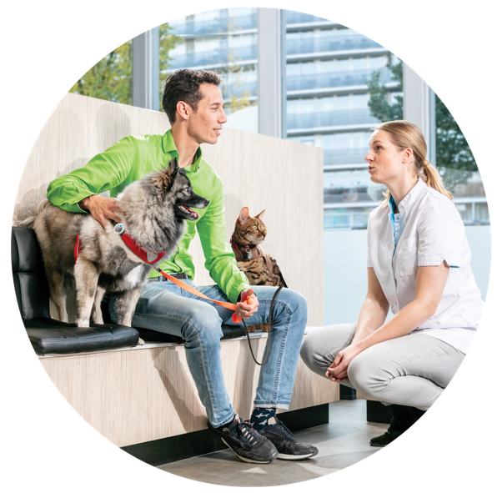
Program details
For the 1-year (+3 month) guarantee, 2-year (+3 month) guarantee, and the 3-year (+3 month) guarantees to be valid, all pets must have completed an age-appropriate initial vaccination series, with the Merck Animal Health vaccine being the most recent vaccine used in the series, unless otherwise specified. Note: The current AAHA Canine Vaccination Guidelines recommend vaccinating puppies out to 18-20 weeks for DAPPv vaccines (www.aaha.org/guidelines/canine_vaccination_guidelines.aspx).
For the 3-year (+3 month) guarantee to be valid for 1-year licensed products, a booster vaccine must be administered at 1 year (can be given as early as 6 months in cats for HCP and HCPCh) after the initial series is completed before going to a 3-year interval.
For all Nobivac® injectable vaccines: The guarantee becomes effective 3 weeks after the most recent vaccine administration date. Any case involving onset of disease within 3 weeks of final vaccination will be handled on a case-by-case basis by our Technical Services Department.
Claims involving animal species other than those on the product label are not covered.
Payments made under the guarantee program may require a signed release form from the pet owner.
Merck Animal Health’s determination of coverage will be final.

Slide 8
Disease-specific terms
Parvovirus:
Puppies (under 20 weeks of age) must have at least 2 doses of a veterinarian-administered, parvovirus‐ containing vaccine with the last dose being a Nobivac® vaccine administered when the puppy is at least 12 weeks of age.
Dogs 20 weeks and older must have at least 1 dose of a Nobivac® parvovirus vaccine as the last dose administered.
All qualifying dogs must have a positive parvovirus ELISA test (or other confirmatory tests) occurring at least 3 weeks after the dose administered when the dog was at least 12 weeks of age.
Additional diagnostic testing may be requested (cost covered by Merck Animal Health).
Lyme:
For dogs previously properly vaccinated with a Lyme vaccine other than Nobivac® Lyme, it is recommended that they test negative for Lyme at the time of vaccination and receive an initial 2 dose series with Nobivac® Lyme for optimal protection. However, these dogs will be covered under the guarantee after receiving a single dose of Nobivac® Lyme if there have been no gaps in vaccination.
A negative Lyme test is not required unless the dog was previously positive for Lyme. Contact Merck Animal Health Technical Services for guidelines.
Dogs with no previous Lyme vaccinations are required to complete an appropriate 2-dose vaccination series with Nobivac® Lyme vaccine to receive support under the guarantee.
If any dog has a positive Lyme test after vaccination with Nobivac® Lyme, Merck Animal Health Technical Services may request and will support the cost of an additional, confirmatory Lyme test.

Slide 9
Disease-specific terms
Canine Influenza:
All dogs must receive an initial 2-dose vaccination series required for primary immunization. Dogs previously properly vaccinated with a canine influenza vaccine other than Nobivac® NXT Canine Flu H3N2 will be covered under the guarantee after receiving a single dose of Nobivac® NXT Canine Flu H3N2 if there have been no gaps in vaccination.
Annual vaccination is required for Nobivac® NXT Canine Flu H3N2.
This guarantee covers diagnostics and treatment of H3N2 and H3N8 up to $5,000.
Leptospirosis:
All dogs must receive an initial 2-dose vaccination series required for primary immunization. For dogs previously properly vaccinated with a Lepto 4 vaccine other than Nobivac® Lepto₄, these dogs will be covered under the guarantee after receiving a single dose of Nobivac® Lepto₄ if there have been no gaps in vaccination.
If converting a dog from a 2-way to a 4-way Leptospira vaccine, the dog must receive a 2-dose vaccination series with a Nobivac® Lepto₄ vaccine for complete 4-way protection.
If any dog has a positive leptospirosis test after vaccination with Nobivac® Lepto, Technical Services may request and will support the cost of additional, confirmatory leptospirosis testing.
Nobivac® Lepto₄ and Nobivac EDGE® Lepto₄ can be used interchangeably.

Slide 10
Disease-specific terms
Feline Leukemia:
All cats must have a record of a current negative feline leukemia blood test at the time of initial vaccination. In addition, there must be no lapses in vaccination for over 2 years without a new negative feline leukemia blood test at the time of revaccination.
First-time vaccinates must receive 2 doses of Nobivac® Feline 2-FeLV or Nobivac® NXT FeLV.
Adult cats with a history of appropriate vaccination with another manufacturer’s feline leukemia vaccine will qualify for the full provisions of the guarantee if the last vaccine received was Nobivac® Feline 2-FeLV or Nobivac® NXT FeLV.
Fibrosarcomas:
Merck Animal Health will cover up to $5000 in treatment and approved diagnostics for cases in which the Nobivac® vaccine was the most recent vaccine administered and it is likely that no other vaccines or injections (from another manufacturer) played a role.
If multiple vaccines had been administered at the fibrosarcoma site over the past 5 years (regardless of which vaccine was administered most recently), Merck Animal Health can cover the appropriate reimbursement fraction based on the number of Nobivac® vaccines given in the previous 5-year period.
Proof of vaccination with a Nobivac® vaccine and anatomical site must be provided.

Slide 11
Steps for reporting a product complaint to Merck Animal Health
1.
2.
3.
Contact Merck Animal Health Technical Services
1-800-224-5318
Provide the following details
Veterinary Clinic and Pet Owner contact information.
Patient ID: First and last name, along with species. If available: breed, DOB, weight, gender/neuter status.
Product information: Product name, size, serial number, expiration date, and dates of vaccination.
Description of the problem: Start and end dates of clinical signs, treatment administered, and patient status.
For Efficacy complaints,
Merck Animal Health may request diagnostics
Whenever possible, please contact Merck Animal Health Technical Services before submitting diagnostic samples to discuss qualification for the Nobivac® Guarantee, and to discuss a diagnostic sampling plan.
Samples taken before contacting Merck Animal Health Technical Services should be stored according to diagnostic laboratory recommendations.
Merck Animal Health Technical Services will provide a diagnostic submission form and cover the cost of diagnostics when the conditions of the Nobivac® Guarantee are met.

Slide 12
Thank you
Copyright © 2024 Merck & Co., Inc., Rahway, NJ, USA and its affiliates. All rights reserved. US-NOV-220900020 951003

