Slide 1
Notes:
SCRIPT:
In this training module, you will learn about the proper management of the vaccine cooler in your store. Some of the topics included are ordering, reading expiration dates, rotating stock, checking cooler temperatures and more.

Slide 2
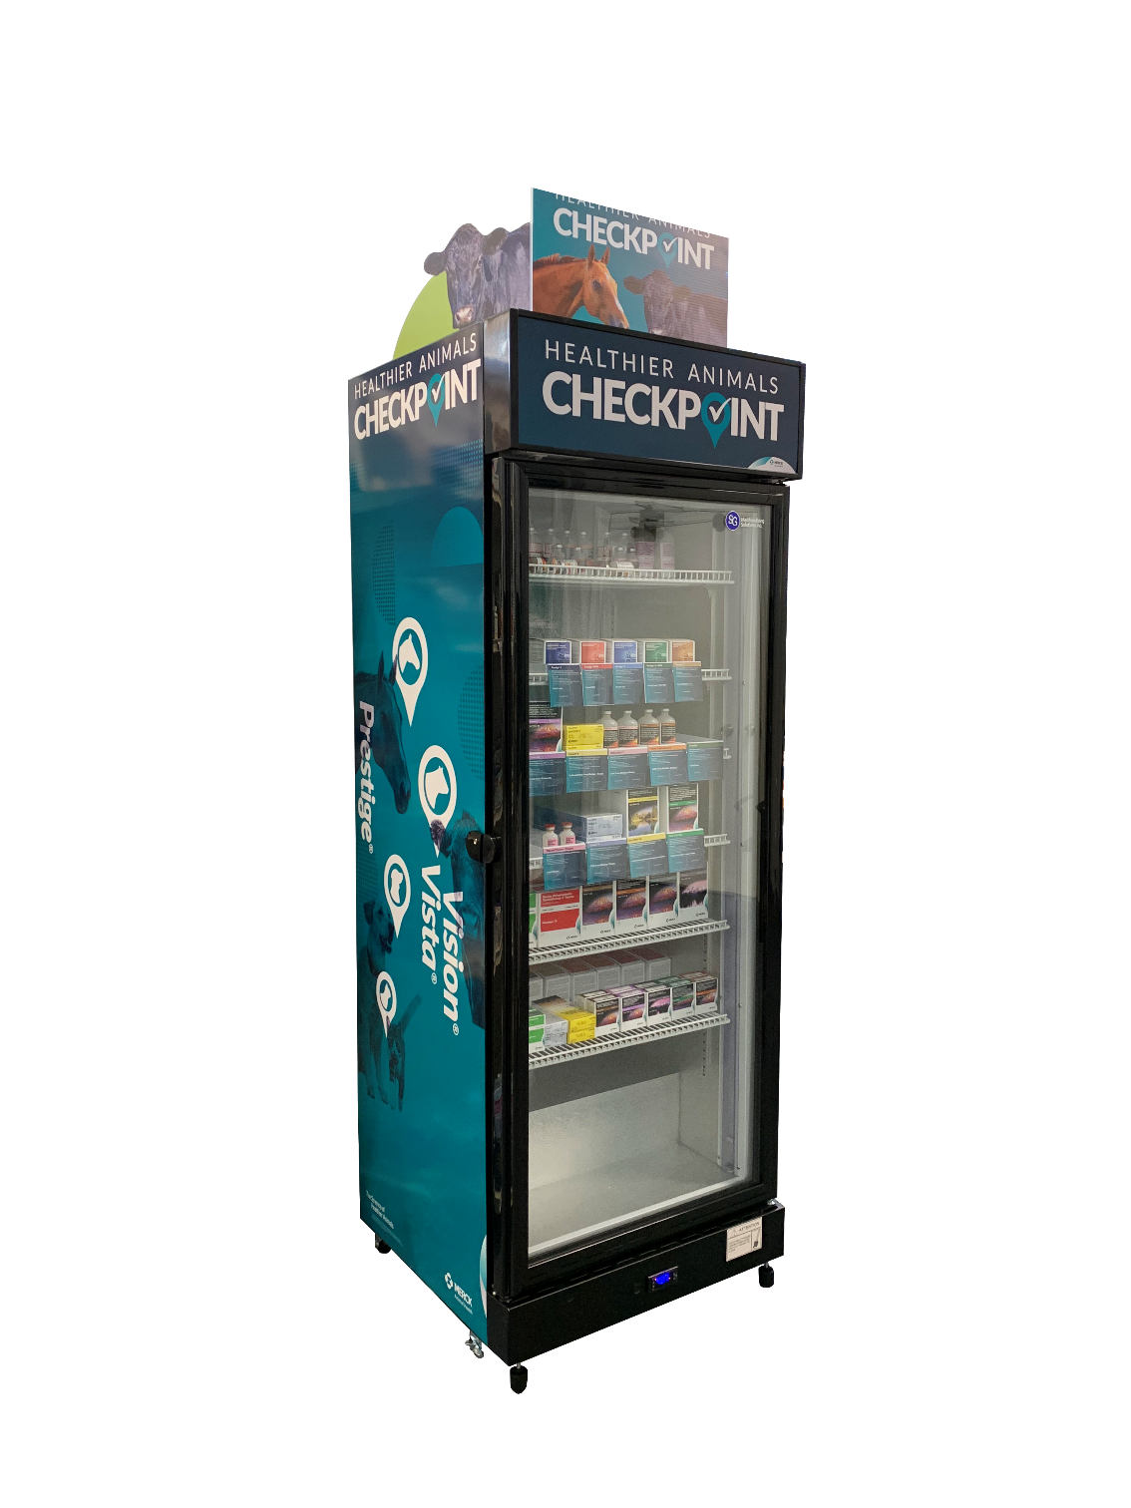
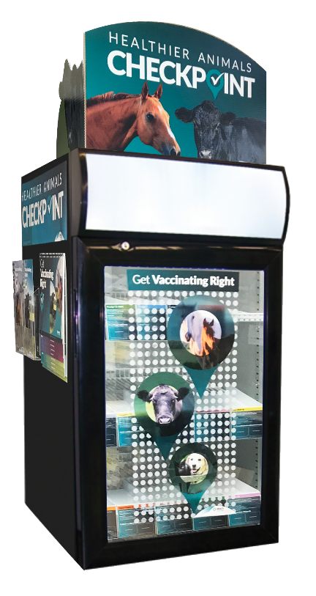
Vaccines must be refrigerated at all times
Temperature should be between 35° and 45° F
Temperature should be checked twice a day in the AM & PM
Notes:
SCRIPT:
All vaccines must stay refrigerated at all times. That’s why it is important to make sure a staff member is always present at the time of delivery to stock the vaccines in coolers, so make sure you order your shipments accordingly. Distribution recommends making your orders between Monday and Wednesday to stay on schedule.

Slide 3
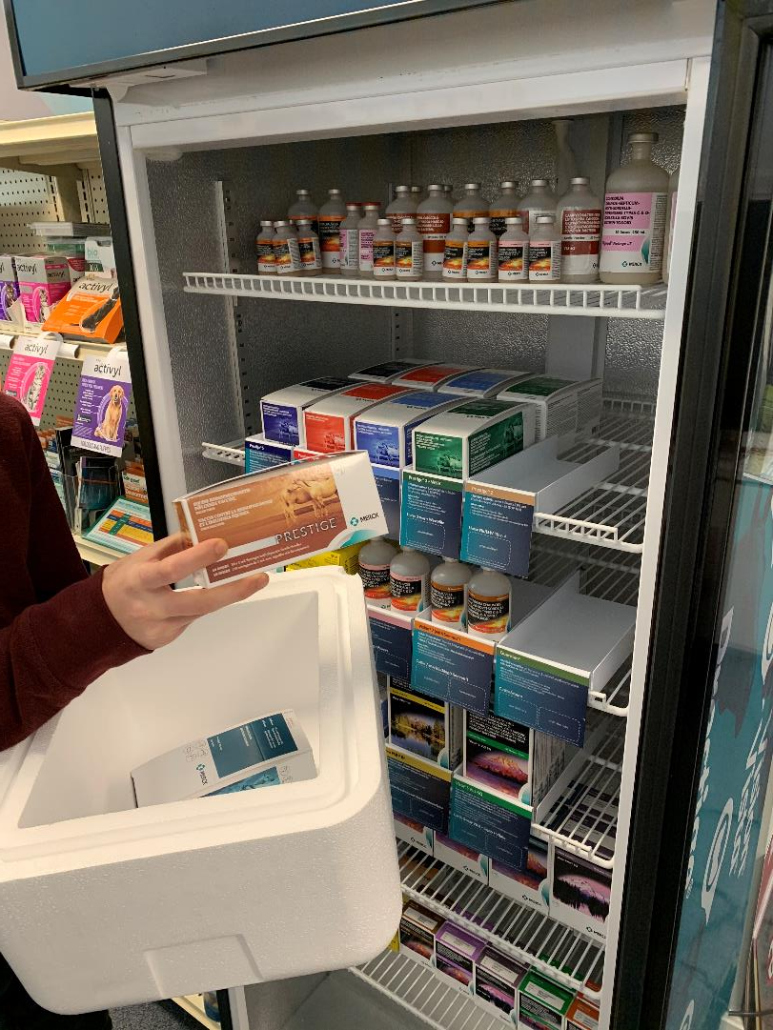
Ordering Vaccines
Staff member must be present at time of delivery
Orders should be placed Monday-Wednesday
Keep vaccines at the recommended temperature at all times
Check for damage and expiration dates on newly arrived vaccines as well as those currently in the cooler
Notes:
SCRIPT:
Upon receiving the vaccines, we recommend checking for any damage or expiration dates. This is also a good opportunity to check your cooler’s temperature, since the vaccines need to be kept at a specific temperature to stay effective.

Slide 4
How to read an expiration date on a vaccine
All vaccines have an expiration date
Most are printed on the package like the examples below:
Keep vaccines with the shortest dating in the front and the longest dating toward the back
*Check the expiration date
Notes:
SCRIPT:
Learning to read the expiration date on vaccines is crucial. Every vaccine has one, and most are printed on the packaging in obvious places like in these three photos.
When stocking, make sure to keep the vaccines with the shortest dating as at the front of the cooler and those vaccines with the longest dating towards the back.

Slide 5
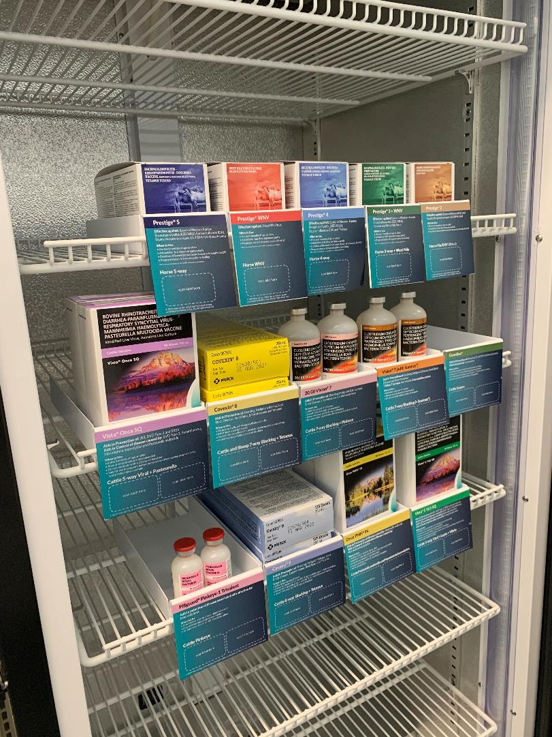
Rotation of stock
Vaccine rotation is very important
Vaccines should be rotated on a regular basis
Keep the closest expiration date up front in the cooler
Expired Vaccines
Expired vaccines can be returned to the distributor for a partial credit, check your distributor’s return policy for details
Notes:
SCRIPT: Vaccine rotation is very important to make sure the shortest dating remains at the front and the longest dating towards the back of the cooler. This will help prevent having expired vaccines.
Vaccines should be rotated on a regular basis and when new vaccines arrive, remember to place the vaccines with the closest expiration date to the front, so they are first to be sold. Vaccines with longer expiration dates can be placed towards the back of the cooler and moved up as their expiration date nears.
If a Merck Animal Health vaccine is not sold prior to the expiration date, the vaccine can be returned to the distributor for a partial credit. Please check with your distributor for their return policy.

Slide 6
Checking your cooler’s temperature
Date | Time | Temperature | Employee Initials
1/15 | 3:30 | 37°F | GS
Cooler temperature should be checked twice a day in the AM & PM
Many stores have a check-off sheet to record:
Date
Time
Temperature
Initials of Store Employee
Visit MoreRetailPower.com for a printable check off sheet
Contact Store Manager if cooler temperature is outside of 35° and 45° degrees.
Notes:
SCRIPT:
Your cooler’s temperature should be checked twice a day—once when the store opens and again when it closes.
We recommend creating a form for daily temperature monitoring, stock rotation, and inventory levels. On this form, you can record the date, time, temperature, and employee initials.

Slide 7
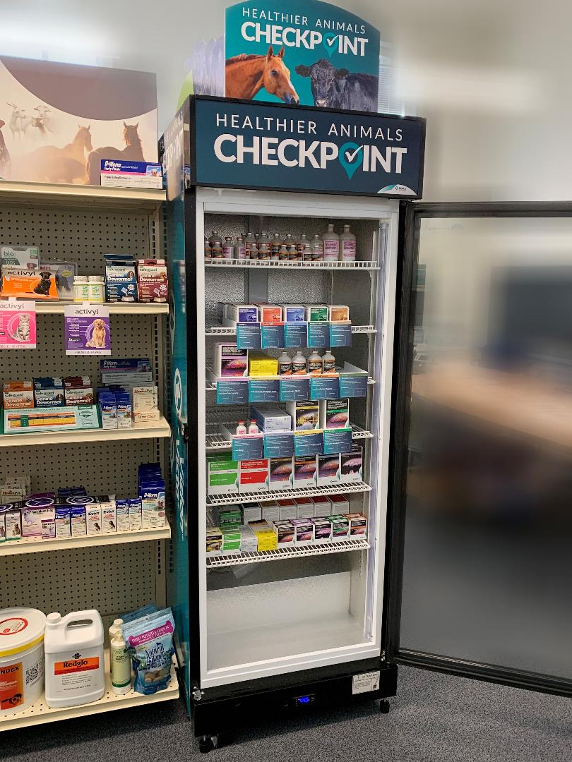
Importance of maintaining vaccine inventory
Perception is everything–your cooler should look full and orderly
Customers can’t buy what they can’t see. They’ll be unlikely to buy:
The last item on the shelf
Dusty or damaged items
If they can’t find what they need, they will shop elsewhere
Notes:
Script: It is important to maintain a stocked cooler so you have vaccine inventory when a customer comes into your store. Perception is everything, and a customer can not buy what they can not see. If they do not find what they are looking for, chances are they will do their shopping somewhere else.
Customers will rarely buy the last item on a shelf, and if the item is dusty or damaged, it is not going to sell. A best practice is to always stock the best looking items, and make sure they are presentable.

Slide 8
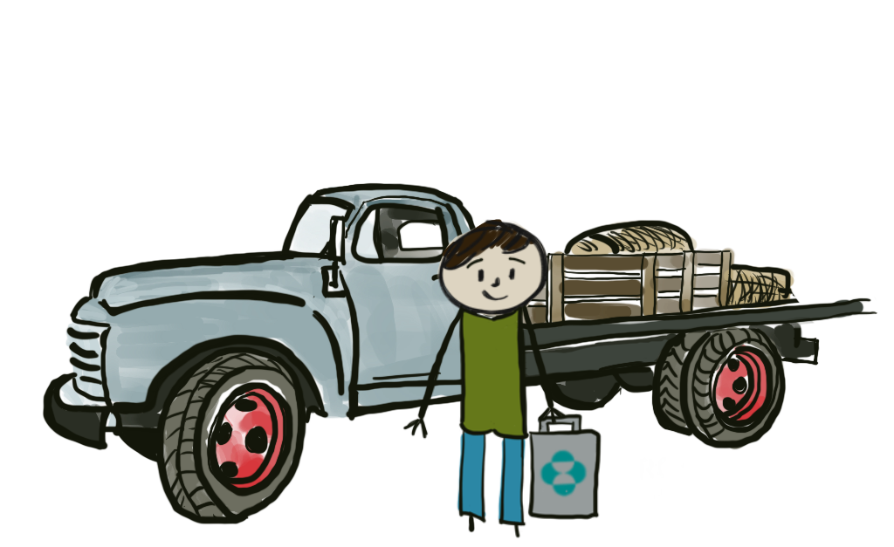
Selling Vaccines
Once a customer makes a vaccine purchase, be sure they understand the importance of keeping vaccines properly cooled:
In transport
At home before use
Notes:
Once a customer makes a vaccine purchase, be sure they understand the importance of keeping vaccines properly cooled both in transport and at home.

Slide 9
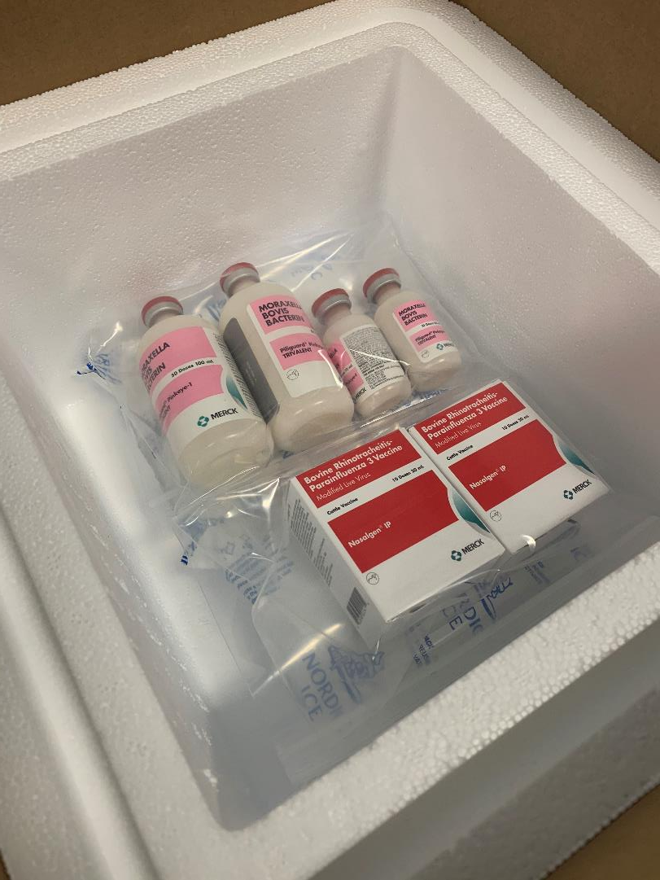
Selling Vaccines
If their trip time home could exceed 15 minutes, it is recommended to pack vaccines for transport using a:
Cooler of their own
A cooler bag provided by the retailer
Notes:
If their trip home could exceed 15 minutes, recommend they pack their vaccines in a cooler of their own or one provided by or purchased from your store

Slide 10
Cooler Maintenance
Obtain proper maintenance information from cooler manufacturer
Best practices
Keep clean inside & out
Leave enough room between cooler and wall for proper ventilation
Electricity source
Only keep vaccines in the cooler
If possible, include a monitoring system in cooler
Notes:
SCRIPT: Check with your cooler manufacturer for proper maintenance on your cooler. Best practices include keeping your cooler clean—inside and out. Leave enough room between your cooler and the wall to allow for proper ventilation and make sure your electricity source is in working order.
Only keep vaccines in the cooler. Employee drinks and lunches should be kept in the break room.
If possible, it is best to include a monitoring system in your cooler to help alert you when temperatures are not at the recommended level.

Slide 11
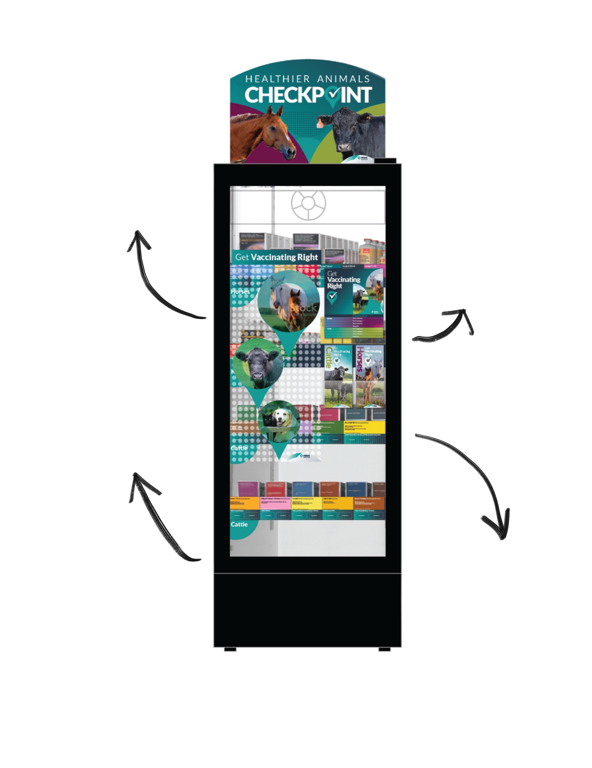
Keep proper temperature
Cooler Maintenance
Maintain
inventory
Vaccine coolers must be:
In good working order to protect the valuable vaccine stock they hold
Consumer friendly for customer appeal
Clean inside and out
Rotation of
stock
Notes:
SCRIPT:
To protect the valuable vaccine stock and keep your cooler in good working order, make sure to keep the proper temperature, maintain inventory, clean inside and out, and rotate the stock.
Best practices include keeping a consumer-friendly cooler for customer appeal.

Slide 12
Closing Comments
For tech service questions or to report adverse reactions, please call:
Companion Animal Technical Services, 800-224-5318
Livestock Technical Services – cows, pigs, poultry, aquaculture, 800-211-3573
Equine Technical Services, 866-349-3497
For animal toxicity questions, call ASPCA at 888-426-4435
For more information watch our Conversational Cooler Training presentation at www.Partnertraining365.com
Please contact retailteam@merck.com for:
Cooler supplies
Trays, flipbooks, brochures and other merchandise
If you have any questions, please reach out to your Retail Representative
Notes:
SCRIPT:
Thank you for learning about cooler management. If you have any questions about this training, please speak to your Merck Animal Health Representative.

Slide 13
Thank You
2 Giralda Farms | Madison, NJ 07940 | merck-animal-health-usa.com | 800-521-5767
Copyright © 2021 Intervet Inc., d/b/a Merck Animal Health, a subsidiary of Merck & Co., Inc. All rights reserved.
Notes:
SCRIPT: Thank you for taking the time to review the Proper Handling of Vaccines and Cooler Management training module from Merck Animal Health. If you have any questions, please reach out to your Merck Animal Health Representative.
Now we will test your knowledge with 4 quiz questions.

